Slide 1
Data Structures
Binary Search Trees I
Dr. Wedad Hussein
Information Systems Department
wedad.hussein@cis.asu.edu.eg
Dr. Asmaa Kassem
Computer Science Department
Asmaa.bahai@cis.asu.edu.eg

Slide 2
Course Contents
Pointers & Classes.
Stacks
Queues
Array Lists
Linked Lists
Binary Search Trees I
Binary Search Trees II +STL
Hash Tables

Slide 3
Linear vs. Non-Linear Data Structures
Linear
Stacks
Queues
Non-Linear
Trees
Graphs
Lists

Slide 4
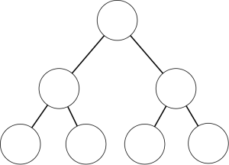
Trees

Slide 5
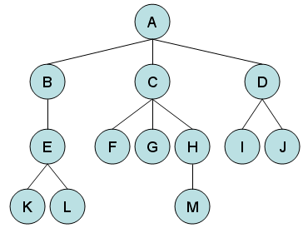
Trees
Root
Parent
Child
Siblings
Leaf Nodes

Slide 6
Trees
Subtree

Slide 7
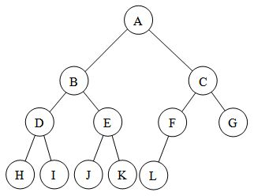
Binary Tree
A binary tree is a tree in which no node can have more than two children.

Slide 8
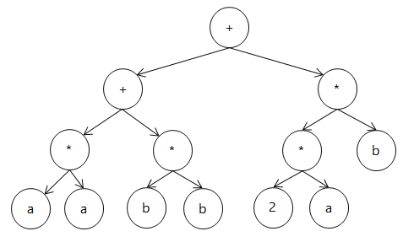
Application: Expression Tree
For the expression: (a*b+c*d) + (e*f*g)
+
+
*
*
*
*
g
a
b
c
d
e
f

Slide 9
Binary Search Trees

Slide 10
Binary Search Tree (BST)
An important application of binary trees is their use in searching.
The property that makes a binary tree into a binary search tree is that for every node X:
the values of all the items in its left subtree are smaller than the item in X.
and, the values of all the items in its right subtree are larger than the item in X.
The average running time of most operations is O(logN).

Slide 11
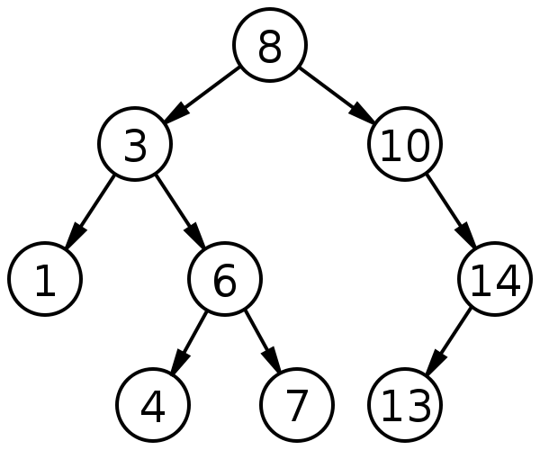
Binary Search Tree Example

Slide 12
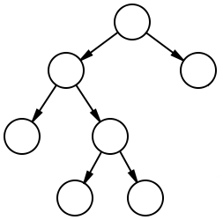
Which is a BST?
(1)
(2)
6
6
2
8
2
8
1
4
1
4
3
7
3
7

Slide 13
Implementation

Slide 14
Tree Node
template <class T>
class Node
{
T value;
Node<T> *left;
Node<T> *right;
};
Value
Left
Right

Slide 15
BST Operations
Contains(value): returns true if “value” exists in the tree.
Insert(value): adds a value to the tree.
Traverse: (display) displays all nodes in the tree.
Remove(value): deletes a node from the tree.

Slide 16
BST Operations
Contains(value): returns true if “value” exists in the tree.
Insert(value): adds a value to the tree.
Traverse: (display) displays all nodes in the tree.
Remove(value): deletes a node from the tree.

Slide 17
Contains
Find(55)
60
>55
41
74
16
53
65
25
46
55
63
70
42
64

Slide 18
Contains
Find(55)
60
41
74
<55
16
53
65
25
46
55
63
70
42
64

Slide 19
Contains
Find(55)
60
41
74
16
53
<55
65
25
46
55
63
70
42
64

Slide 20
Contains
Find(55)
60
41
74
16
53
65
25
46
55
63
70
42
64

Slide 21
BST Operations
Contains(value): returns true if “value” exists in the tree.
Insert(value): adds a value to the tree.
Traverse: (display) displays all nodes in the tree.
Remove(value): deletes a node from the tree.

Slide 22
Insert
Insert (48)
60
>48
Has left child
41
74
16
53
65
25
46
55
63
70
42
64

Slide 23
Insert
Insert (48)
60
41
74
<48
Has right child
16
53
65
25
46
55
63
70
42
64

Slide 24
Insert
Insert (48)
60
41
74
16
53
>48
65
Has left child
25
46
55
63
70
42
64

Slide 25
Insert
Insert (48)
60
41
74
16
53
65
<48
25
46
55
63
70
42
64
Has no right Child

Slide 26
Insert
Insert (48)
60
41
74
16
53
65
25
46
55
63
70
42
48
64

Slide 27
Exercise
Draw the Binary Search Tree resulting from inserting the following values in the same order:
100, 200, 90, 150, 125, 88, 99, 210

Slide 28
Solution
100
90
200
88
99
150
210
125

Slide 29
BST Operations
Contains(value): returns true if “value” exists in the tree.
Insert(value): adds a value to the tree.
Traverse: (display) displays all nodes in the tree.
Remove(value): deletes a node from the tree.

Slide 30
Tree Traversal
A tree traversal is a specific order in which to trace the nodes of a tree.
There are 3 common methods:
In-order: left, root, right.
Pre-order: root, left, right.
Post-order: left, right, root.

Slide 31
1. In-order Traversal
63
7
11
3
41
74
5
1
16
53
65
9
4
6
8
2
25
46
55
64
70
10
The In-order traversal gives: 16, 25, 41, 46, 53, 55, 63, 64, 65, 70, 74.
For a Binary Search Tree, it prints out a sorted list.

Slide 32
2. Pre-order Traversal
63
1
8
2
41
74
5
3
16
53
65
9
4
6
7
10
11
25
46
55
64
70
The Pre-order traversal gives: 63, 41, 16, 25, 53, 46, 55, 74, 65, 64, 70.
Useful for displaying folders and subfolders.

Slide 33
3. Post-order Traversal??
63
41
74
16
53
65
25
46
55
64
70

Slide 34
3. Post-order Traversal
63
11
10
6
41
74
5
2
16
53
65
9
3
4
7
1
8
25
46
55
64
70
The Post-order traversal gives: 25, 16, 46, 55, 53, 41, 64, 70, 65, 74, 63.

Slide 35
Lecture Resources
Lecture Notes.
Lecture Code.
Text Book:
Chapter 4: 4.1, 4.2, 4.3

Slide 36
Thank You

